Slide 2
Objectives
Understand the program development life cycle:
Analysis - including abstraction, decomposition, problem identification requirements
Design – including decomposition, structure diagrams, flowcharts and pseudocode
Coding – writing program code and iterative testing
Testing – testing program code with test data

Slide 3

Starter
How is large software created?
Describe the process that software developers use

Slide 4
Software development
There are many processes that software developers use including:
Agile development
Incremental development
Rapid application development (RAD)
Waterfall development
In this topic we will consider the life cycle stages as used in waterfall development

Slide 5


Life cycle stages
There are four stages in the program development life cycle:
Analysis
Design
Coding
Testing
These are covered further in this topic

Slide 6

Analysis
Analysis involves considering the problem that needs to be solved computationally
Which of the following tasks form part of the analysis stage?
Abstraction
Decomposition of the problem
Structure diagrams
Identification of the problem
Identification of the requirements
Flowcharts
Pseudocode
Writing program code

Slide 7
Analysis
Which of the following tasks form part of the analysis stage?
Abstraction, decomposition of the problem, identification of the problem and requirements
Abstraction
Decomposition of the problem
Structure diagrams
Identification of the problem
Identification of the requirements
Flowcharts
Pseudocode
Writing program code

Slide 8
Problem and requirements
A basketball team wants some software which will automatically send players updates of when and where games are held and results of matches
A project may start with such an overall aim
The analysis section will aim to determine exactly what the problem is and what the requirements are
What questions would you ask the basketball team’s manager in order to identify the problem and create a set of requirements?

Slide 9
Problem and requirements
A basketball team wants some software which will automatically send players updates of when and where games are held and results of matches
Example questions:
What information needs to be stored and sent out for the game information?
How will the updates and results be sent?
Which results are sent out?
Do the results need further analysis?
How often are updates sent out and who are they sent to?

Slide 10
Requirements
Once the problem has been decomposed it is possible to produce a list of requirements
This is often called a requirements specification
Requirements for the basketball software:
The software will store the game, place, date, time and result
One email will be sent three days before the game
The result will be sent as soon as the game is over
All current players will be stored in the system; only these players will be sent the information

Slide 11

Problem decomposition
When we build a house we decompose the problem into different parts such as how many rooms are needed
In problem decomposition, we break down the problem into all the smaller parts that need to be solved
Problem decomposition is from the client point of view – it shows each part of the problem but not how it will actually be solved

Slide 12
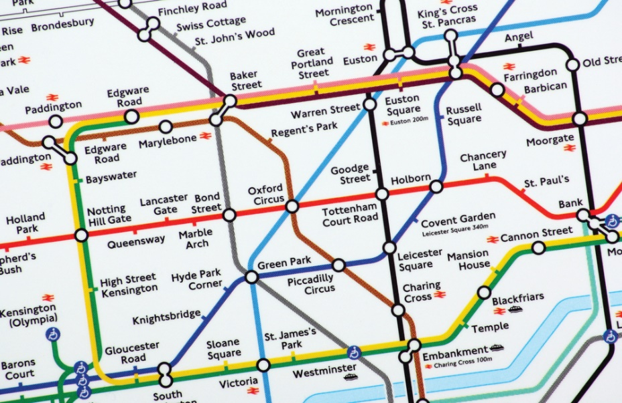
Abstraction
Abstraction involves removing unnecessary detail from a problem so that you can focus on the essential components
The London Underground map is a good example of abstraction

Slide 13
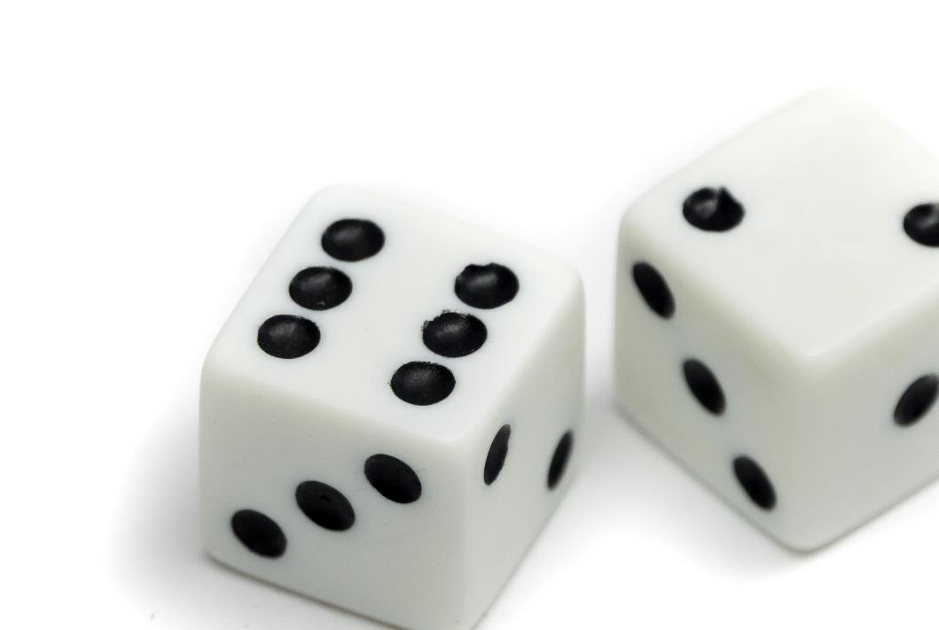

Abstraction
When you write a program to play a game involving dice with a computer, how does the computer ‘roll the dice’?

Slide 14
Rolling dice
When a computer rolls a dice we can use abstraction to remove unnecessary details
It will depend on the problem being solved as to what is and isn’t important
A computer game may need to show a graphical representation of a dice – but they may be able to abstract away all the details about the surface it rolls onto and the physics of the bounce
Many programs just need a random number – in which case they don’t need to worry about how the dice appears, its weight or how the spots are arranged – they can just find a random number with one line of programming code

Slide 15
Worksheet 1
Complete Task 1 and Task 2 on Worksheet 1

Slide 16
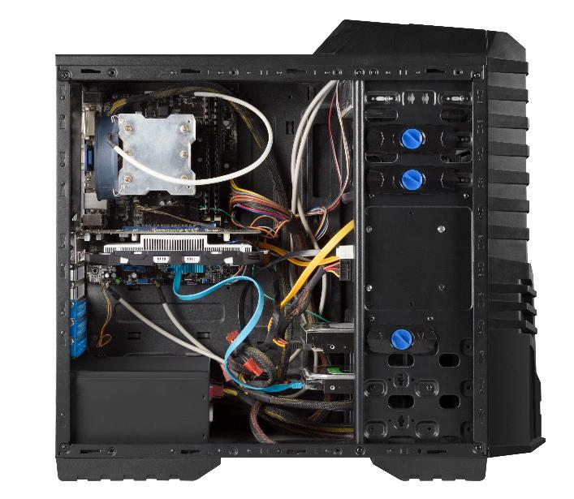
Sub-systems
All computer systems are made up of sub-systems
These sub-systems are made up of further systems
The systems and sub-systems may be hardware, or they can be software
What are three physical and three software sub-systems of a home computer?

Slide 17
Sub-systems
Computer system physical sub-systems
Hard drive / storage
CPU / processing
RAM / main memory
Computer system software sub-systems
Operating system
Office applications
Computer games
Each of these sub-systems are made up of further sub-systems

Slide 18

Design
The design stage takes the requirements that come out of the Analysis stage
In the design stage, we are considering how the program and software itself will be designed
We are interested in both the overall structure and individual algorithms that may be used

Slide 19
Decomposition
A key part of the design stage is decomposition
The problem and requirements are broken down into smaller parts that are solvable by a computer
In the design stage, we are interested in how we solve the problem. The problem is broken down into component parts such as:
Inputs, processes, outputs and storage
Structure diagrams are a graphical way of showing how a problem is broken down

Slide 20
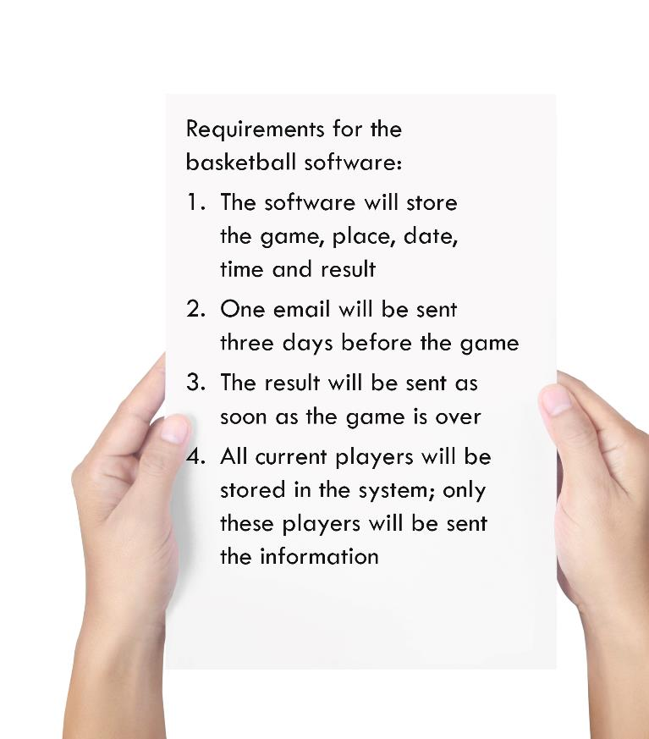

Structure diagrams
A structure diagram uses boxes and branches
Each part of the problem is broken down again and again until each part is easy enough to understand and develop
Compete a structure diagram for the requirements
Basketball software
Store current player details

Slide 21
Structure diagrams
One possible answer is shown below
More levels would be required for larger projects
Basketball software
Store current player details
Store details
Results
Create emails
Send emails

Slide 22
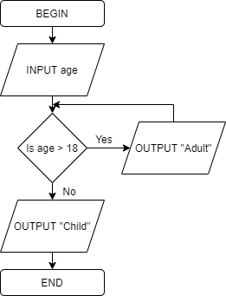
Flowcharts
Flowcharts are a way in which algorithms and processes may be shown graphically
The flowchart shows a an algorithm for choosing appropriate tickets for a basketball game at a stadium
Flowcharts will be looked at in more detail in the next topic

Slide 23
Pseudocode
It is often easier for programmers to write pseudocode than create a flowchart
Pseudocode is very similar to a programming language, however, it is easier to understand regardless of what language a developer knows
Pseudocode | C#
FOR i ← 0 TO 10 OUTPUT i NEXT i | using System; public class Program { public static void Main() { for (int i=0; i<10; i++) { Console.WriteLine(i); } } }

Slide 24
Worksheet 1
Complete Task 3 on Worksheet 1

Slide 25



Development / Coding
The next stage in the lifecycle is producing the software itself
This is often known as the development stage
In IGCSE it is known as the coding stage

Slide 26
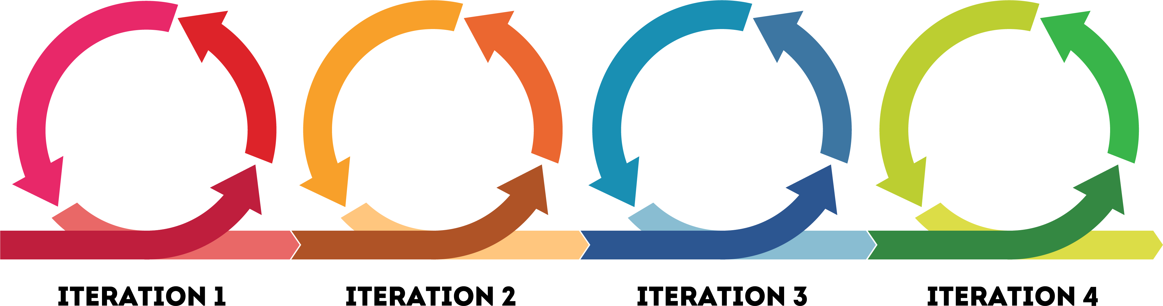
Iterative testing
Programs are tested as they are developed
Each time the program is updated to add a new feature or fix a problem is known as an iteration
The testing of each iteration is known as iterative testing

Slide 27

Testing
The final stage of the product lifecycle is the testing stage
Before the program is written, a set of tests will be designed along with expected results
Once the program is complete, the tests will be carried out with test data to check that the program output matches the expected results
If any tests fail, the errors are fixed before being re-tested
What could the test data be for a program that reverses an integer that is between 1 and 5 digits long?

Slide 28
Testing
One possible test table showing the test data required and expected output
In the testing stage the actual output and pass/fail columns will be completed
Test # | Test data | Test reason | Expected output | Actual output | Pass/ Fail
1 | 342 | 3 digit number | 243
2 | 8 | 1 digit number | 8
3 | 84237 | 5 digit number | 73248
4 | 832735 | 6 digit number | Number too long

Slide 29
Worksheet 1
Complete Task 4 on Worksheet 1

Slide 30
Plenary
Describe the tasks that are involved in each of the stages of the program development life cycle
Decomposition of the problem
Testing with test data
Identification of the problem
Abstraction
Identification of the requirements
Structure diagrams
Pseudocode
Writing program code
Iterative testing
Flowcharts
Decomposition

Slide 31
Plenary
Describe the tasks that are involved in each of the stages of the program development life cycle
Decomposition of the problem
Testing with test data
Identification of the problem
Abstraction
Identification of the requirements
Structure diagrams
Pseudocode
Writing program code
Iterative testing
Flowcharts
Decomposition

